Slide 1
Exploratory Data Analysis
<Project name> GM2 Insight For Cab Investment Firm
<Date>15.05.2023

Slide 2
Agenda
Executive Summary
Problem Statement
Approach
EDA
EDA Summary
Recommendations

Slide 3
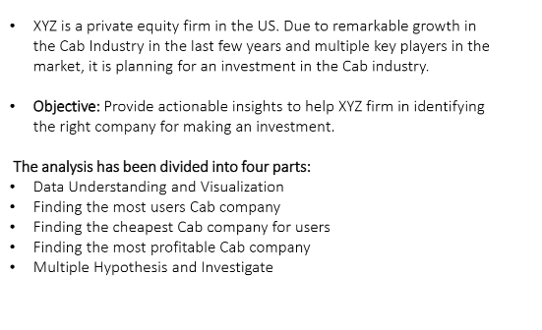
Problem Statement

Slide 4
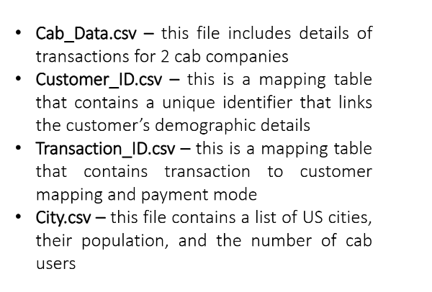
Data Information

Slide 5
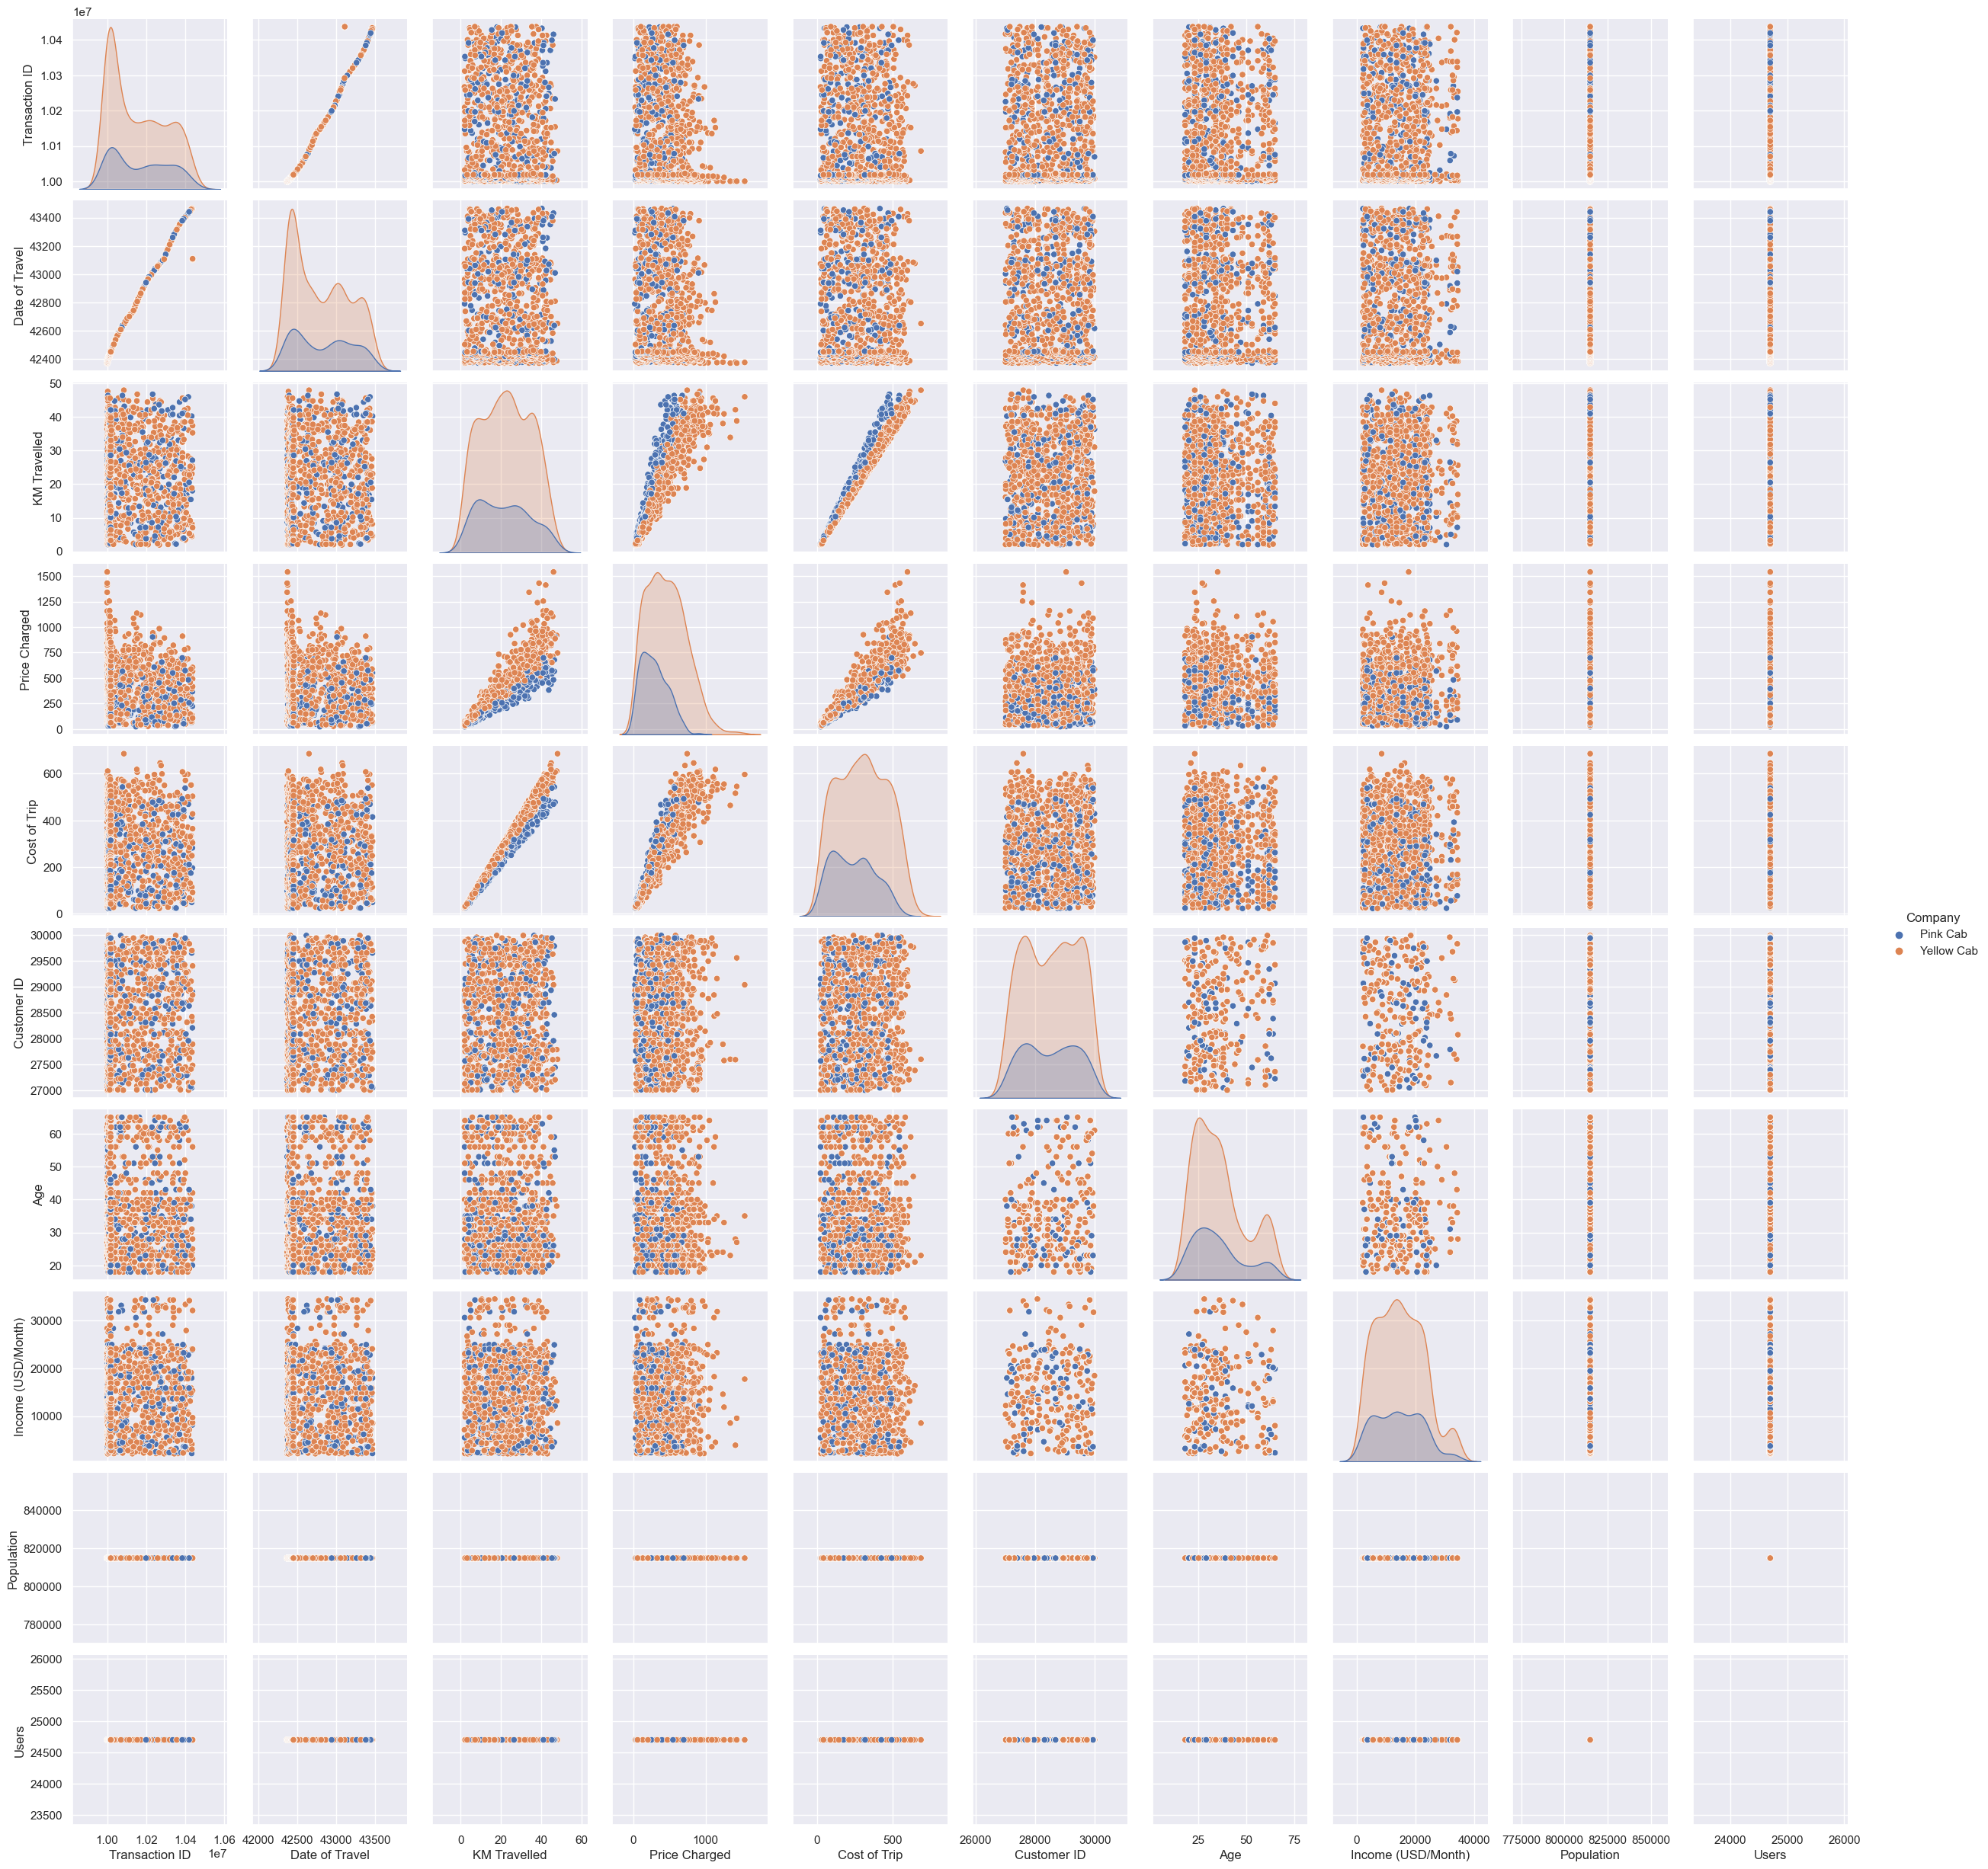
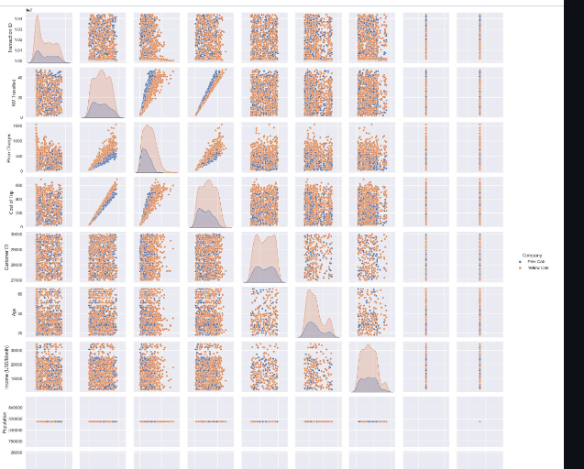
Relationships Between Variables

Slide 6
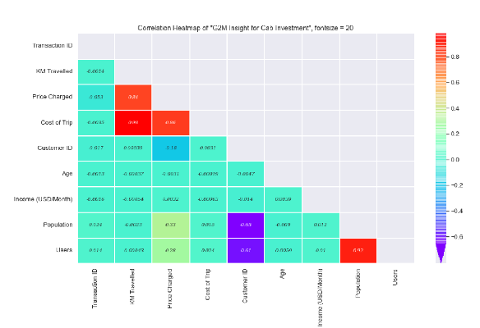
Correlation Between Variables

Slide 7
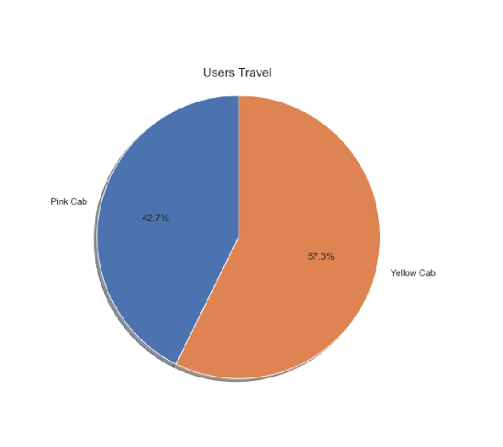
Which Company has more users?

Slide 8
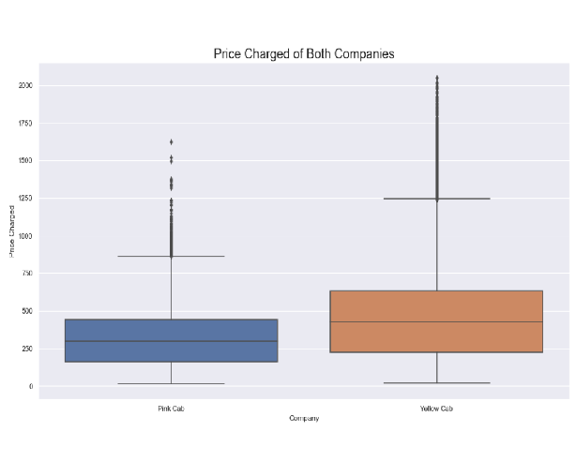
Which Company has a high price charged?

Slide 9
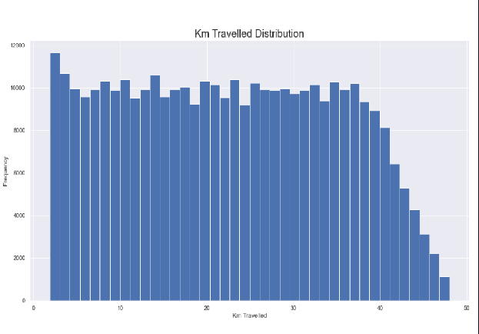
KM Travelled Distribution

Slide 10
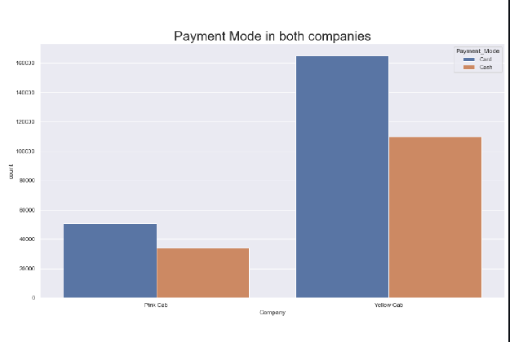
Payment Mode

Slide 11
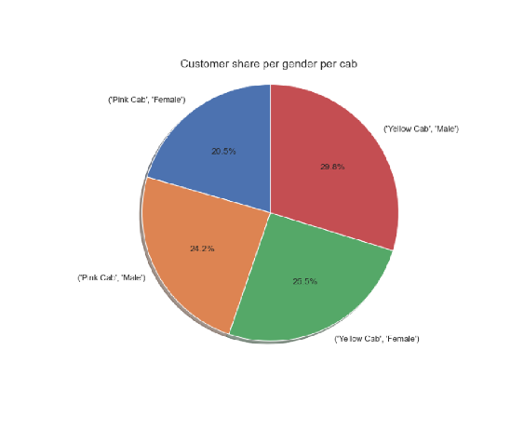
Users w.r.t Genders

Slide 12
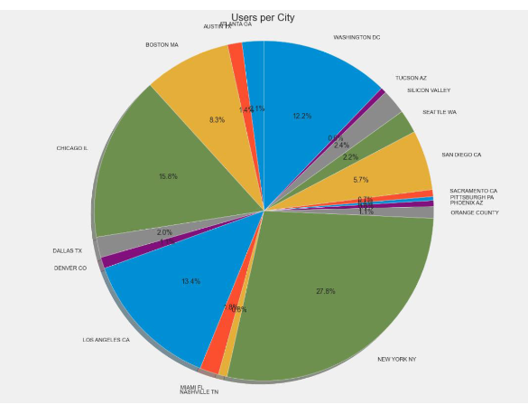
Users w.r.t Cities

Slide 13
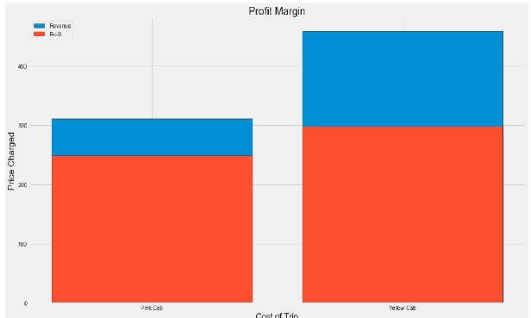
Profit Margin

Slide 14
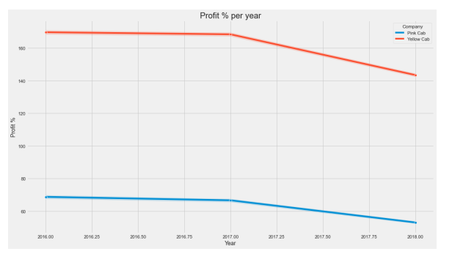
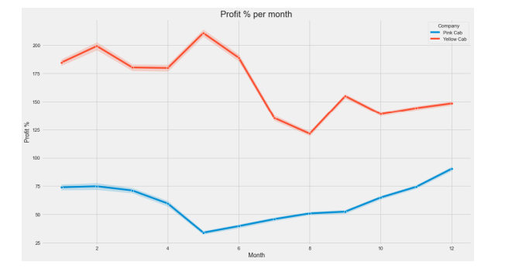
Profit Margin w.r.t Time

Slide 15
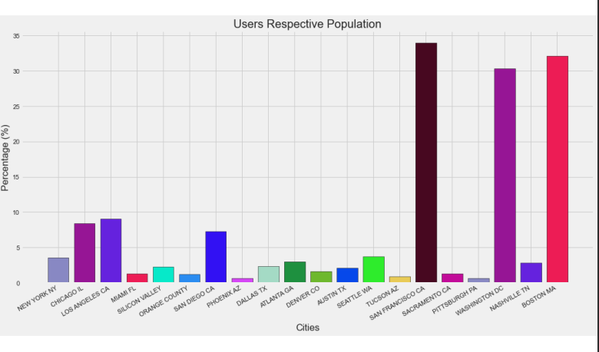
Users w.r.t Population

Slide 16
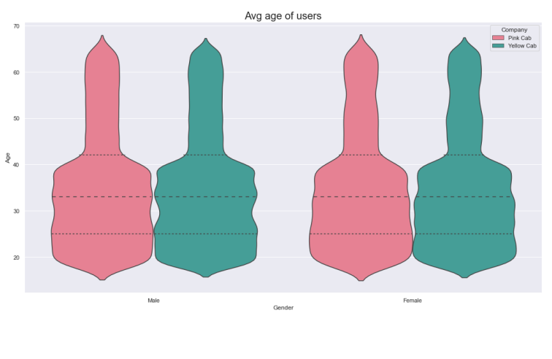
Avarage Age of Users

Slide 17
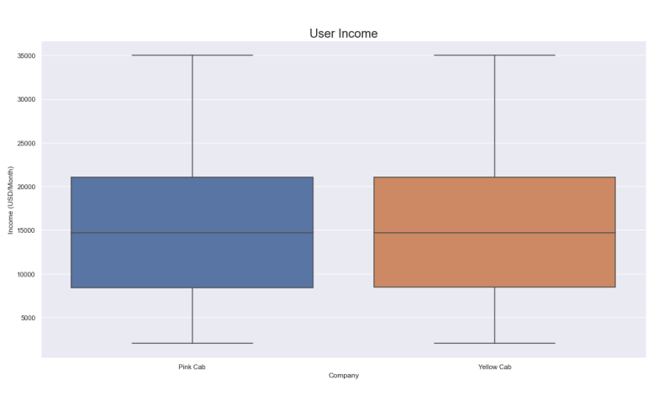
Avarage Income of Users

Slide 18
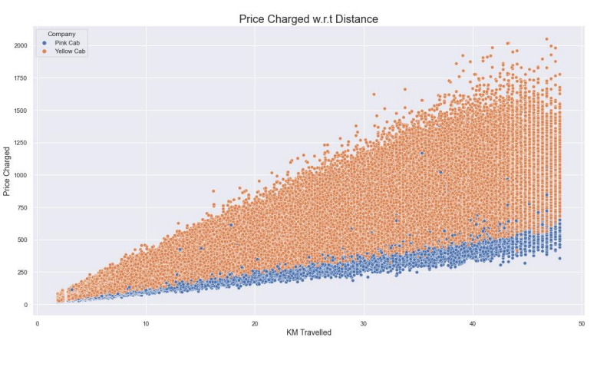
Price Charged w.r.t Distance

Slide 19
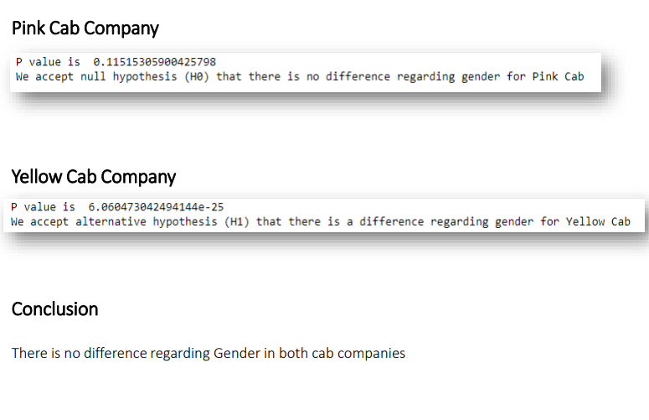
Hypothesis1 : Is there any difference in profit regarding Gender

Slide 20
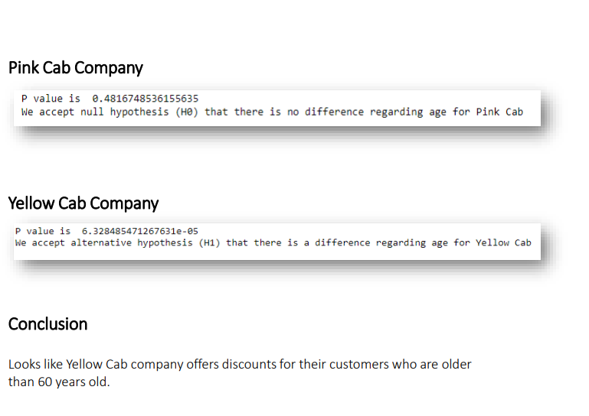
Hypothesis2 : Is there any difference in profit regarding Age

Slide 21
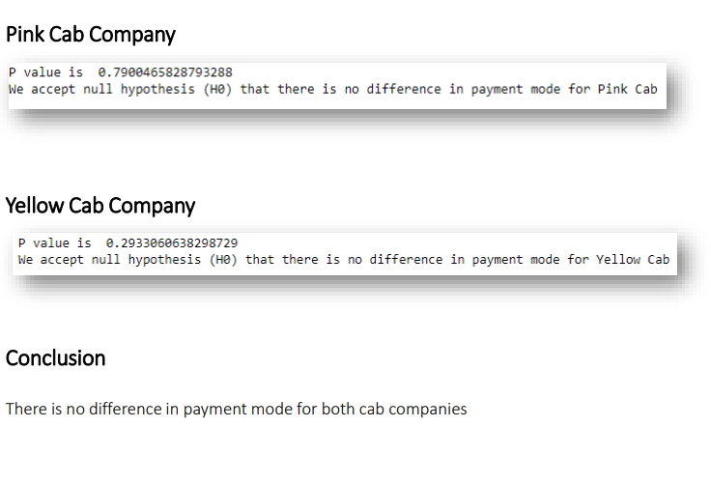
Hypothesis3 : Is there any difference in profit regarding Payment Mode

Slide 22
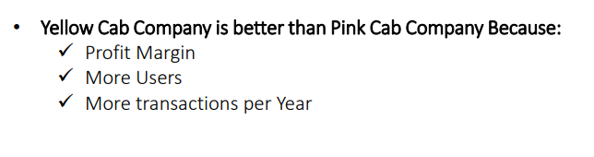
Conclusion

Slide 23
Thank You

